Slide 1
Renewable Energy
Khaled Mahmud Shihab

Slide 2
What is renewable Energy
Renewable energy is a type of energy that comes from sources that are naturally replenished

Slide 3
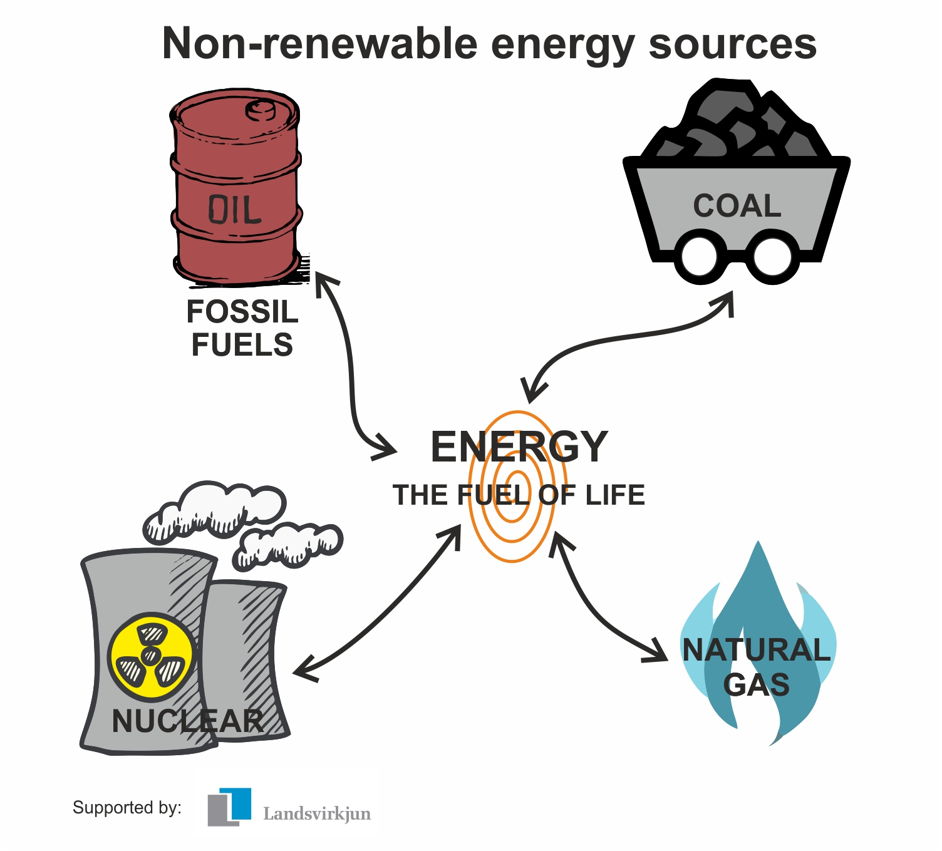
What are non renewable Energy?

Slide 4
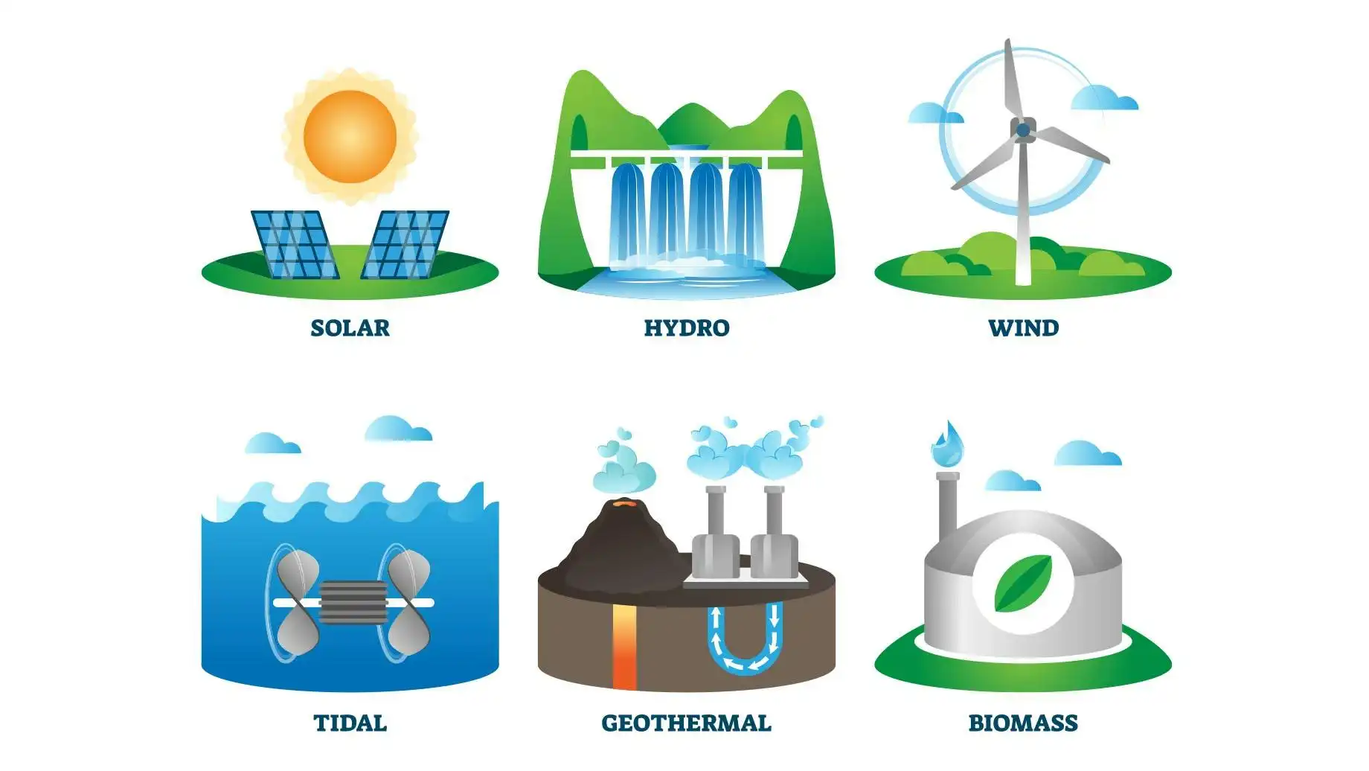
Types of Renewable Energy

Slide 5
Solar
Solar panel uses heat and turns it to electricity
🌍 Global Significance:
Solar power is the fastest-growing energy source globally.
Countries like China, India, the USA, and Germany are investing heavily in solar farms.
Solar energy is empowering off-grid rural areas with no access to electricity.
🌱 Environmental Benefits:
Zero emissions during electricity generation.
Reduces reliance on fossil fuels.
Decreases air and water pollution, contributing to cleaner air and lower health risks.

Slide 6
Wind energy
Use turbines to turns Kinetic Energy to mechanical Energy
🌍 Global Significance:
Major part of the global clean energy mix.
Offshore and onshore wind farms are growing across Europe, the USA, and China.
Expected to meet 35% of global electricity demand by 2050 (according to IRENA)
🌱 Environmental Benefits:
No greenhouse gas emissions from turbines.
Saves billions of liters of water that fossil fuel plants would use for cooling.
Less environmental footprint compared to mining and drilling.

Slide 7
Hydro power
Flow water through dames or turbines and by spinning it create electricity
🌍 Global Significance:
Currently the largest source of renewable electricity worldwide.
[Source: International Hydropower Association, 2022]
Key in countries like Brazil, Canada, Norway, and China.
Used for both energy and water resource management (flood control, irrigation).
🌱 Environmental Benefits:
No fuel combustion = no air pollution.
Helps reduce CO₂ emissions when replacing coal/oil.
Stable power supply with low carbon footprint (if well managed).

Slide 8
Bio Mass
Domestic waste use as fuel
🌍 Global Significance:
Converts waste into energy, used in rural areas and industries.
Biofuels power vehicles in the USA and Brazil.
[Sources: Center for Sustainable Systems]
Offers energy independence by reducing oil imports.
🌱 Environmental Benefits:
Reduces landfill waste and methane emissions.
If sourced sustainably, it can be carbon neutral (plants absorb CO₂ during growth).
Supports circular economy by reusing organic material.

Slide 9
Tidal Energy
Tide of the ocean used to spin turbine and create energy from it
🌍 Global Significance:
Still in early stages, but has huge potential, especially for island nations and coastal areas.
The UK, South Korea, and France are experimenting with tidal power stations.
[Sources: Sources: EMEC (2023), Euronews Green (2025), Wikipedia (Sihwa & La Rance)]
🌱 Environmental Benefits:
No emissions, and tides/waves are predictable and strong.
Low noise and visual impact compared to other sources.
Helps diversify the renewable energy mix, reducing fossil fuel dependency.

Slide 10
Geo thermal energy
Use core heat of the earth. By stream or hot water turbine spin and create electricity
🌍 Global Significance:
Used in the USA, Iceland, the Philippines, and Kenya.
[Wikipedia (2023), Energy Cluster Iceland (2021), Statista (2023)}
Potential to provide baseload power (constant electricity 24/7).
Valuable for regions with volcanic or tectonic activity.
🌱 Environmental Benefits:
Very low emissions compared to fossil fuels.
Uses less land and water than coal plants.
Keeps air cleaner and contributes to long-term climate goals.

Slide 11
Renewable Energy initiatives in Bangladesh
Solar Energy: Bangladesh has made significant strides in solar energy adoption. As of 2022, the country had approximately 537 megawatts (MW) of installed solar photovoltaic (PV) capacity, up from 480 MW in 2021. This growth is primarily driven by the Solar Home Systems (SHS) program, which has provided electricity to millions of rural households lacking grid access.[wekepedia ,researchgate]
Wind Energy: The first commercial wind power plant in Bangladesh, with a capacity of 60 MW, commenced full-scale operation in Cox's Bazar in March 2024. [wekipedia]

Slide 12
Renewable Energy initiatives in Banglades
Hydropower: Hydropower contributes to Bangladesh's renewable energy portfolio, with the Karnafuli Hydroelectric Power Station being the largest facility. However, the potential for large-scale hydropower is limited due to the country's topography.
Biogas and Biomass: These sources are utilized, especially in rural areas, for cooking and electricity generation. Various projects have been implemented to promote biogas plants at the household and community levels.

Slide 13
Future prospect
The government has set ambitious targets to increase the share of renewable energy in the national grid. The Integrated Energy and Power Master Plan of 2023 aims for 18% clean energy by 2030 and 40% by 2041. However, within these targets, only 5.7% by 2030 and 8.8% by 2041 are designated for renewable sources, with the remainder expected from other clean energy forms[Energy Tracker Asia]

Slide 14
Future prospect
Challenges:
Technical and Infrastructure Limitations: The integration of renewable energy into the national grid faces challenges due to inadequate infrastructure and technical expertise. The grid's limited capacity and reliability issues hinder the efficient distribution of renewable energy.
Financial Constraints: High initial investment costs for renewable energy projects pose a significant barrier. Access to financing and incentives for private sector participation remain limited

Slide 15
Future prospect
Challenges:
Policy and Regulatory Framework: Although policies exist to promote renewable energy, their implementation has been inconsistent. Clearer regulations and more robust policy support are necessary to attract investment and facilitate project development
Land Scarcity: The high population density and limited availability of land present challenges for large-scale renewable energy projects, particularly solar farms

Slide 16
Future prospect
While Bangladesh has made notable progress in renewable energy development, significant challenges must be addressed to achieve the government's targets. Enhancing grid infrastructure, providing financial incentives, streamlining policy implementation, and exploring innovative solutions like rooftop solar installations can help overcome these obstacles. With concerted efforts, Bangladesh can advance towards a more sustainable and diversified energy future.

